Slide 1
Botany—Chapter 1
Welcome to the World of Plants.

Slide 2
Methods for Studying Plants
Religious Methods
  Knowledge through revelation.
  Gods cannot be seen nor studied.
  Faith and belief is key—can explain the unexplainable.
Metaphysical systems
  Includes natural AND supernatural forces.
  Allows for the explanation of “luck”, “omens”, etc.

Slide 3
Methods for Studying Plants
(cont’d)
3. Speculative Philosophy
  Analyzing the world by logic.
  Can reach accurate conclusions
    Ex.—the existence of atoms in 400 BC
  There is no verification of conclusions
4. Scientific Method
  Information is derived from observation.
  Claims from or about deities must be verified.
  All observations must be verified.

Slide 4
Steps of the Scientific Method
Define the problem
Research the problem
  You must have an understanding of what you observe.
Form a Hypothesis
  A Hypthesis is a prediction that can be tested.
Experiment
  Experiments are designed to test a hypothesis.
  Must be controlled and test only one variable.
  Results must be measurable.

Slide 5
Steps of the Scientific Method
(cont’d)
5. Collect and analyze results of the experiment
6. Draw conclusions based on results.
The drawback of Science is that it cannot deal with Morality or Emotion.
Euthenasia?
Abortion?
Beauty?
Fear?
Humor?

Slide 6
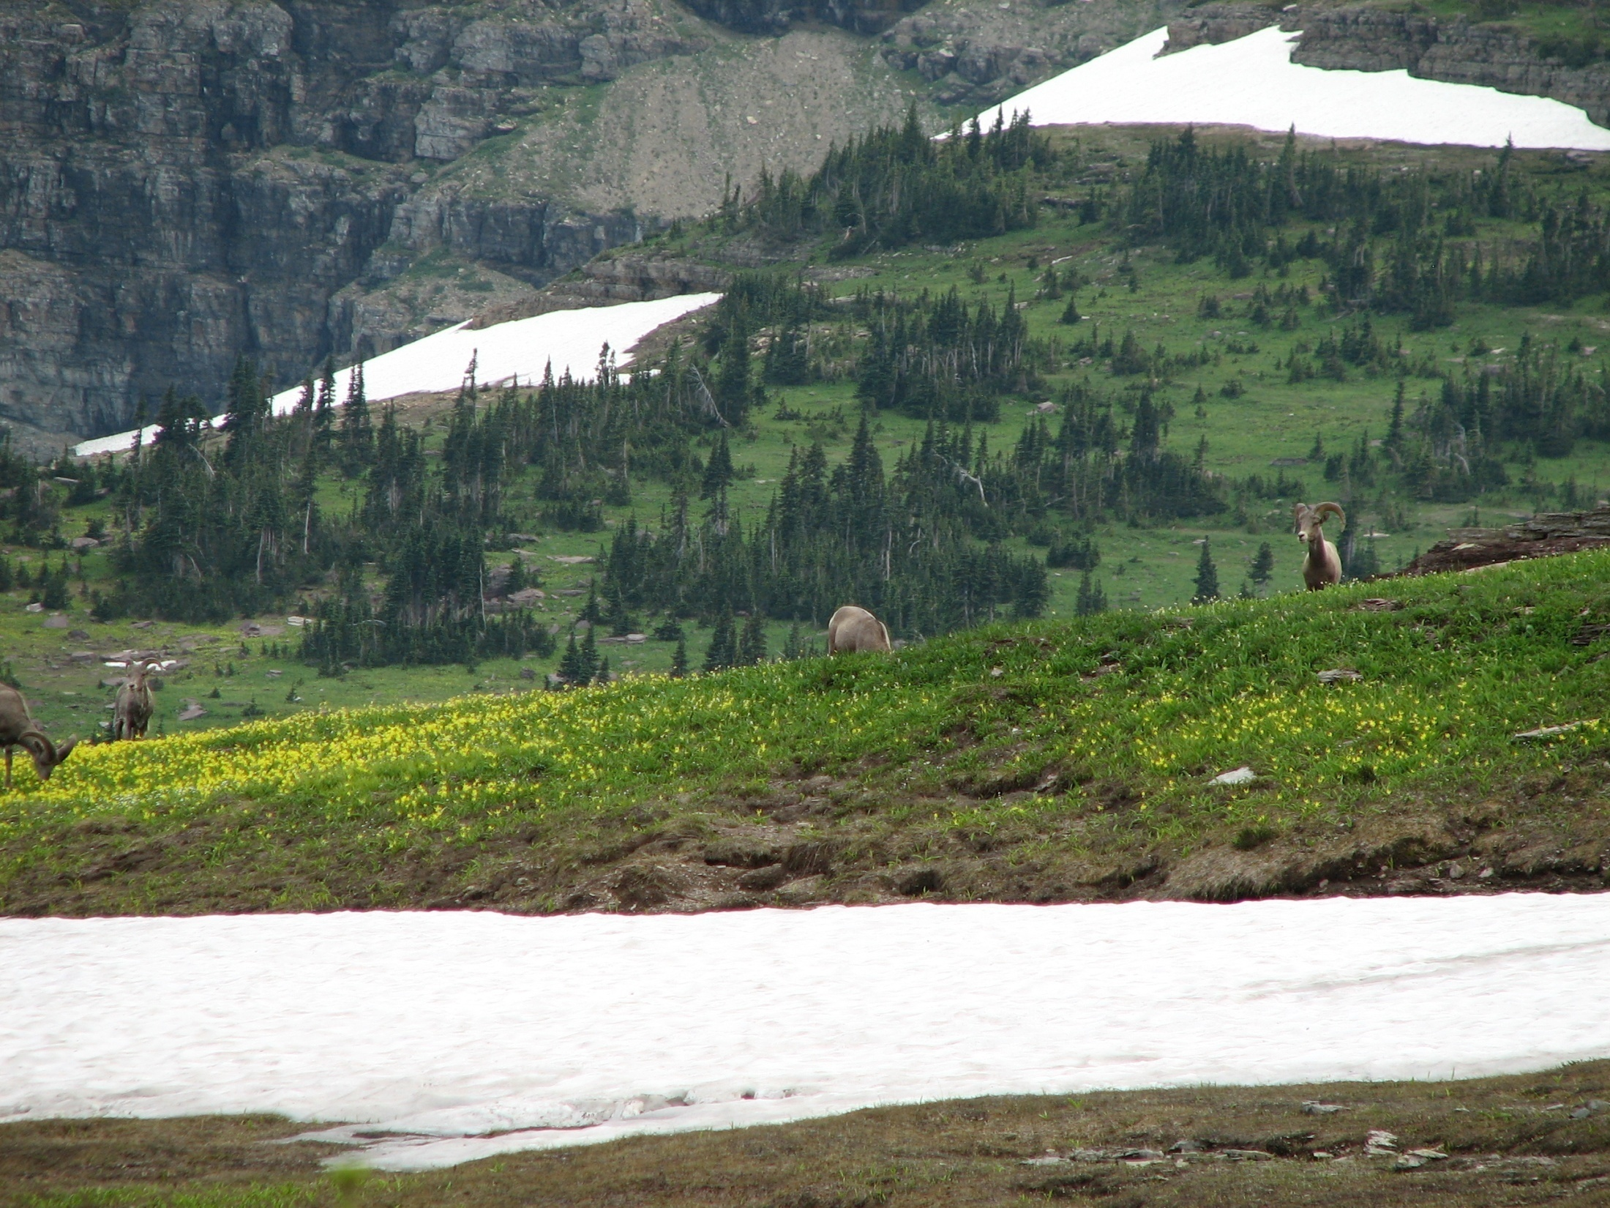

Slide 7


Slide 8


Slide 9
What Defines a Plant?
Plant metabolism is based on chemistry and physics.
Plants have a means of storing and using information.
  DNA
  RNA
Plants reproduce and pass genes on to descendents.
Genes can change

Slide 10
Plants must survive in their environment.
Plants are complex.
Individuals are the result of interaction between genes and the environment.
(note trees on my desktop)
Plants have no purpose nor decision making ability.

Slide 11
Development of Plants
The inclusion of one primitive cell into another that formed Eukaryotic cells is called the Endosymbiotic Theory. (Click)
  This is how Eukaryotic cells began.
Upright growth in plants is the result of a beneficial genetic mutation.
  Allowed those plants to gather more sunlight.
Relictual features are those that have changed little over time.
Derived features evolved from something else.
Alternative adaptations are various responses to the environment.
  Plants must be able to survive different situations.

