Slide 1
Today in Botany
Chapter 7 Notes

Slide 2
Botany Chapter 7 leaves
OBJECTIVES
Understand the functions of leaves
Where does photosynthesis occur?
Identify various leaf forms
Opposite v. alternate
Simple v compound
Why are there other leaf forms?
Identify internal leaf structures

Slide 3
Leaf Functions and Characteristics
Leaves can provide:
Protection
Support
Storage
Acquire nitrogen
Perform photosynthesis
Each function requires special adaptations.
We are most familiar with foliage leaves, but other types exist.

Slide 4
Characteristics and Function (cont’d)
Leaves must have the following characteristics:
Not lose excessive water
Prevent entry by bacteria, fungi, algae
Not be so delicious and nutritious to animals
Not act as sails that will break the plant
Be “cost effective” to build -- require less energy than photosynthesis makes
Lamina must be thin to be efficient in absorbing light.

Slide 5
Characteristics and Function (cont’d)
Functions of the Petiole
Holds the leaf out into the sunlight—reduces self-shading
Allows for “leaf flutter” – reduces the ability of insects and fungus spores to land
Provides a structure for vascular tissue to and from leaf.
**Monocots often have leaf sheath instead of petiole**

Slide 6
Characteristics and Function (cont’d)
Leaf shape:
leaves may be simple or compound
Compound leaves have leaflets and rachis
leaf shape follows function, e.g., large leaves for floating on water
all leaf shapes are probably equal in adaptive advantage – this results in a wide variety of leaf shapes.

Slide 7
Characteristics and Function (cont’d)
Venation (leaf veins)
large main vein is called a midrib
monocots have parallel venation—veins run parallel and lengthwise
dicots have reticulate venation—veins in a netted formation off the midrib

Slide 8
Characteristics and Function (cont’d)
Leaf Loss
Abscission zone located at the base of the petiole
Abscission zone is were leaf is cut off after its useful life
Abscission zone prevents uneven tearing off of leaf—doesn’t wound plant
Leaf scar forms over abscission zone on the stem—prevents infection
Leaf loss triggered by photoperiod(?), temperature(?).
Leaf loss occurs in deciduous trees.

Slide 9
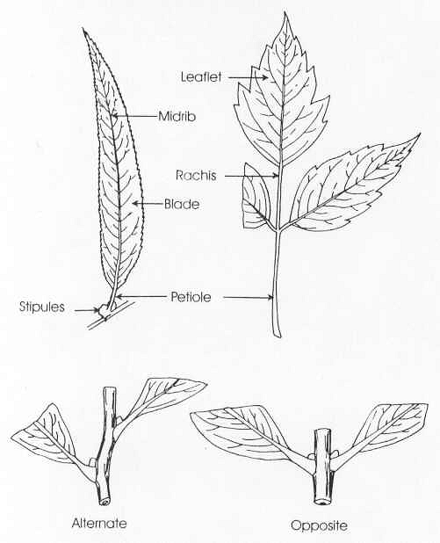

Slide 10
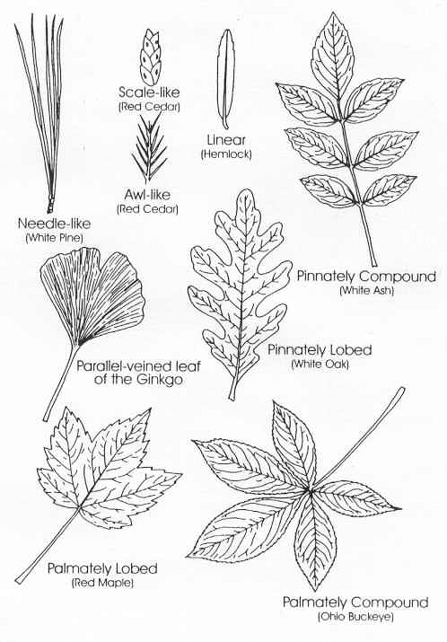

Slide 11
Internal Structure (foliage leaves)
Epidermis
Must be translucent (light can get through)
Must be reasonably waterproof
Water loss through the epidermis is called Transpiration
There are more stoma in the lower epidermis than the upper epidermis (table 6.2)
Stomata may be completely lacking in upper epidermis
Helps prevent water loss
Helps prevent disease
Epidermis may have hairs
Provides shade to epidermis
Makes it difficult for insects to chew
Slows air movement across the surface (stops venturi effect)

Slide 12
Mesophyll (tissue below the epidermis – “insides”)
Palisade parenchyma (just below the epidermis)
Main photosynthetic tissue
Generally only one cell layer thick
Cells are lined up parallel (fig 6.20) and surrounded by air
Cells do NOT touch each other (allows diffusion of air)
Spongy Mesophyll
Loosely packed cells inside the leaf
Allows for the easy diffusion of CO₂ & O₂

Slide 13
Vascular Tissue
Large vascular bundle in the center of the leaf is called the midrib
Dicots—lateral veins are mesh-like
Monocots—lateral veins run parallel to midrib
Vascular bundles run from stem to leaf through the petiole
Vascular attachment to stem is Leaf Trace

Slide 14
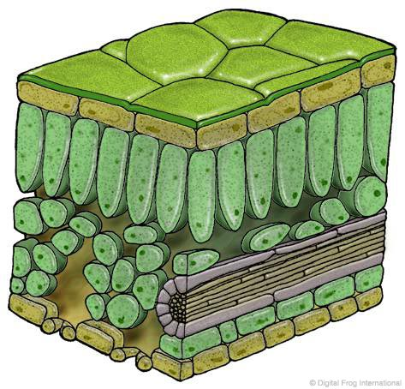

Slide 15
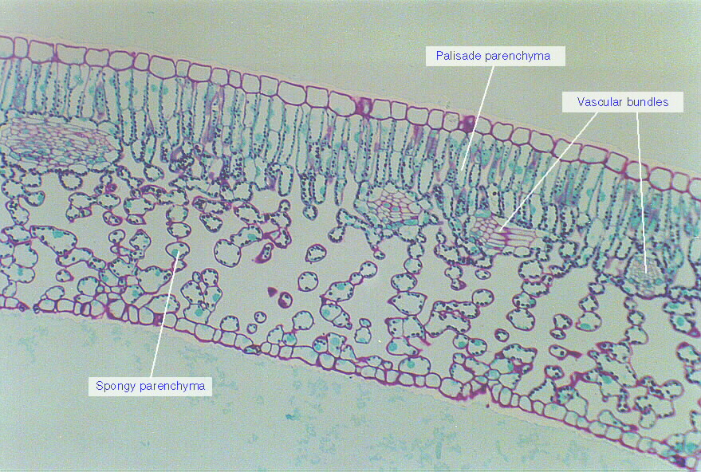

Slide 16
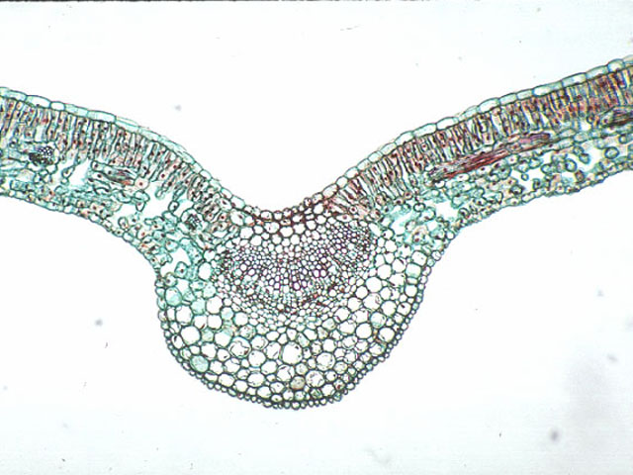

Slide 17
OTHER LEAF FORMS
*Kranz Anatomy
Found in plants with C₄ photosynthesis
Lack palisade parenchyma
Helps adapt plants to HOT environments

Slide 18
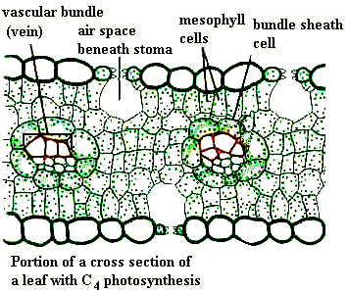

Slide 19
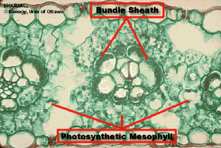

Slide 20
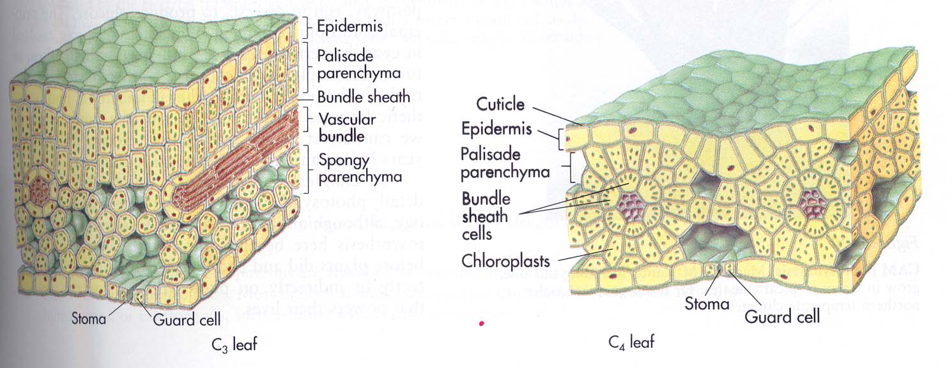

Slide 21
OTHER LEAF FORMS
Succulents
Leaf is thick and fleshy
Allows for water storage
Example: aloe
Schlerophylls
Hard leaves made up of more Sclerenchyma cells
More resistant to animals, fungi and freezing
Ex: holly
Tendrils
Used for support
Wrap around another object
Ex: peas, clematis, morning glory
Insect traps
Supplements nitrogen intake in poor soil
Ex: pitcher plant, venus fly-trap

