Slide 1
Today in Eco/Con
How do populations work?
What makes populations increase?
What makes them decrease?
(Write down your answers on a piece of paper)

Slide 2
Chapter 6
Populations

Slide 3
Biotic Potential
Factors that increase a population
  Reproductive rate
    R strategies
    K strategies
  Ability to migrate (immigrate)
  Ability to invade new habitats
  Defense mechanisms
  Ability to cope with adverse conditions -- hardiness

Slide 4
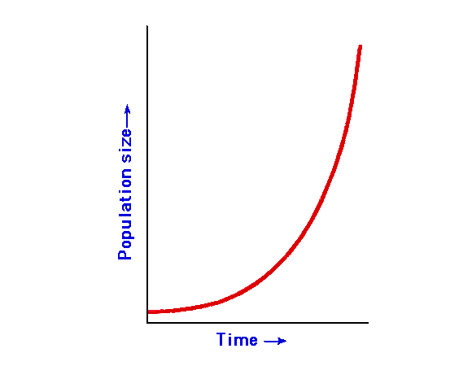

Slide 5
Environmental Resistance
The factors that limit population increases
Abiotic factors
  Temperature
  Water
  Soil pH for plants
  Nutrients
  Space
  “Carrying Capacity”

Slide 6
Environmental Resistance
Biotic Factors
  Predators
  Parasites
  Disease
  Insufficient food
  Competition
Carrying Capacity—”K”
  the max. number the environment can support

Slide 7
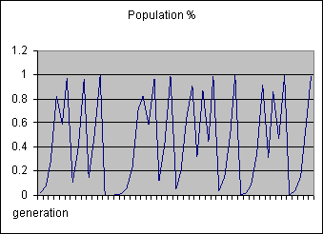
R-strategy model
K

Slide 8
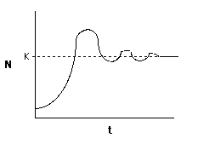
K-strategy model

Slide 9
The Balance (density dependant)
As population density increases
  Environmental resistance increases
  Biotic potential decreases
As population density decreases
  Environmental resistance decrease
  Biotic potential increases

Slide 10
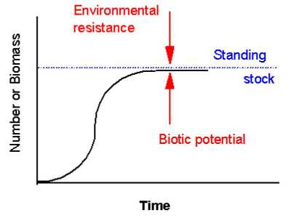
The Balance
Carrying Capacity

Slide 11
How are populations kept in check *
Predator- prey relationships
Migration (emigration)
Carrying capacity—the maximum number the environment can support
Host specific parasites
Disease

Slide 12
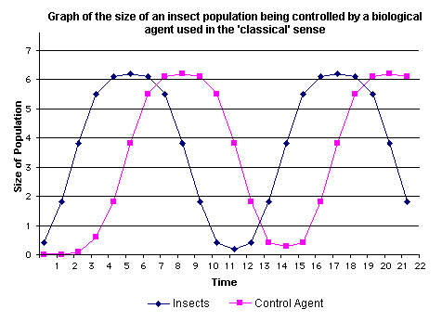
Predator-Prey model

Slide 13
History
Up until the beginning of the early 1800’s, human population grew slowly
Humans had high reproductive rate, but also had high infant and childhood mortality rate.

Slide 14
History
Results from famine and outbreak of diseases kept human population low.
C. 1800, the world population reached 1 billion.
During the 1800’s, the growth rate changed

Slide 15
History
1930, 130 years after reaching 1 billion people, world population reaches 2 billion
30 years later, 1960, the population was 3 billion
15 years later, 1975, the population was 4 billion

Slide 16
History
In 1987, the population reached 5 billion.
In 1992, population was 5.42 billion, that is how old our book is.
In 1999, the population reached 6 billion.
Our current world populations is…

Slide 17
Cool site
http://www.ibiblio.org/lunarbin/worldpop/
Click to see what the estimated population was at any time

Slide 18
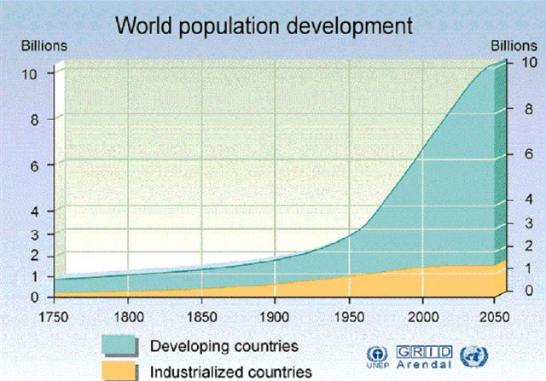

Slide 19
Reasons for Human Growth
Advances in 1800’s
  Sanitation
  Medical knowledge
  Agriculture
  Industry

Slide 20
Reasons for Human Growth
Advances in recent times
  Advances in vaccinations as a result of better understanding of biochemistry
  Better sanitation by pin pointing unsanitary sources
  Antibiotics-greatly cut down on childhood mortality.
  Advances in agricultural technologies including genetics and machines

Slide 21
Rich Nations
High income, highly developed, industrialized
United States
Canada
Japan
Australia
West and Northern Europe

Slide 22
Rich Nations
Hold about 25% of world’s population
80% of the wealth
Can afford to eat what they choose
Live in an apartment or house

Slide 23
Third world countries
Low income, low developed country.
Countries of east and central Africa
Central Asia
Live with limited nutritrition, illiteracy, disease, squalid surroundings, high infant mortality, low life expectancy

Slide 24
Everything in between
Moderately developed and Middle income
Mexico
Northern Africa
Parts of the Middle East

Slide 25
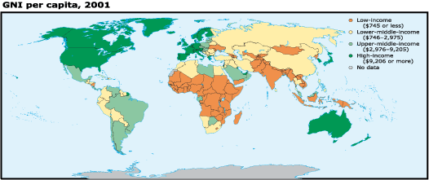

Slide 26
Total fertility rate
The average number of children each woman has over her lifetime

Slide 27
Environmental Regard
Factors that may moderate negative environmental impacts, like recycling and conservation

Slide 28
Negative environmental impact
(Population X consumption of lifestyle)/ environmental regard
The more people and excessive lifestyles = the more negative impact
Environmental regard lessons the negative impact

Slide 29
Consequences of population
Most people used to live in the country.
Most people now live in a city-type setting
People that remain in the country divide land up between children and each child gets less to use= less income than parent

Slide 30
Consequences of population
In order to gain new land, try to convert natural habitat to farm ground
Deforestation
Wetland loss
60% of world population depends on fire for cooking and heating needs. More than 3 billion people in all.

Slide 31
Consequences of population
Forests cut down faster than can grow

Slide 32
Affluence
Increased production, increased consumption, increased use of materials and energy resources.
Stresses the ecosystem just as much as population. Remember formula from above

Slide 33
A sustainable balance= 4 requirements
The need to stabilize human population
Overgrazing, deforestation, soil degradation and erosion must be brought under control. Must sustain agriculture and manage forest

Slide 34
A sustainable balance= 4 requirements
Find ways to provide needs and wants in an environmentally friendly way.
There is a need a higher level of environmental understanding and regard throughout the world. So, environmental education worldwide!

Slide 35
Popluation growth depends on three factors
Age structure
Total fertility
Infant and childhood mortality

Slide 36
Age structure
Population profile- a bar graph showing the age structure of a population

Slide 37
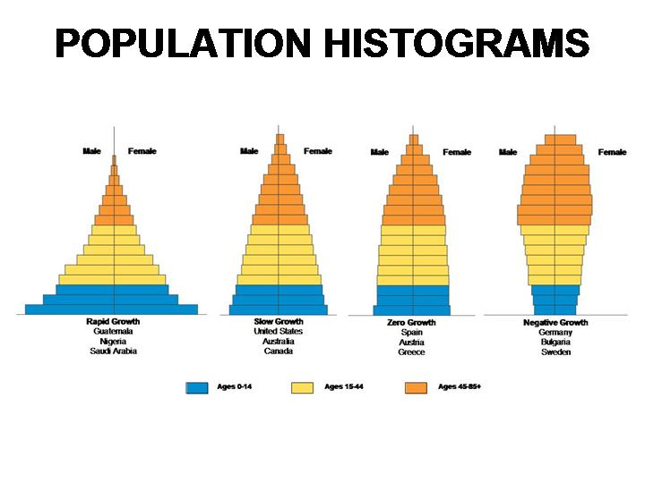

Slide 38
Demographics
The study of populations. Looks at the groups that make up a population.
Factors
  Age- biggest
  Location
  Race
  income

Slide 39
Fertility
Women in developing countries have children at a younger age.
Women in developed countries wait to have children.
Why?
  What do children provide to families in underdeveloped countries?

Slide 40
Population change
CBR- crude birth rate- rate of births per 1000 people
CDR- crude death rate- rate of deaths per 1000 people
The difference is the rate at which the population is growing.

