Slide 1
MICROSCOPES (the tool of the trade)
Targets
Learn the parts
Understand how to use
Learn to make a slide and all that

Slide 2
Microscopes
Always carry using 2 hands
One on base and one on neck
Always 1) go to low power and 2) raise barrel before removing a slide
Never use coarse adjustment on high power
Never use anything but lens paper to clean lens

Slide 3
Microscopes
Diaphragm will adjust the amount of light
start on largest opening
May need to adjust mirror
If you can see the lights clearly, you are not focused properly

Slide 4
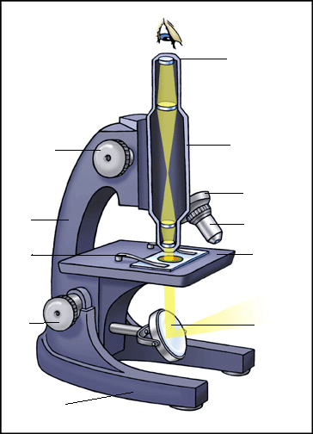
Parts of the Microscope

Slide 5
To end the class
Obtain a slide and a microscope and focus on High Power.
Let me see that you have accomplished this.

